Slide 1

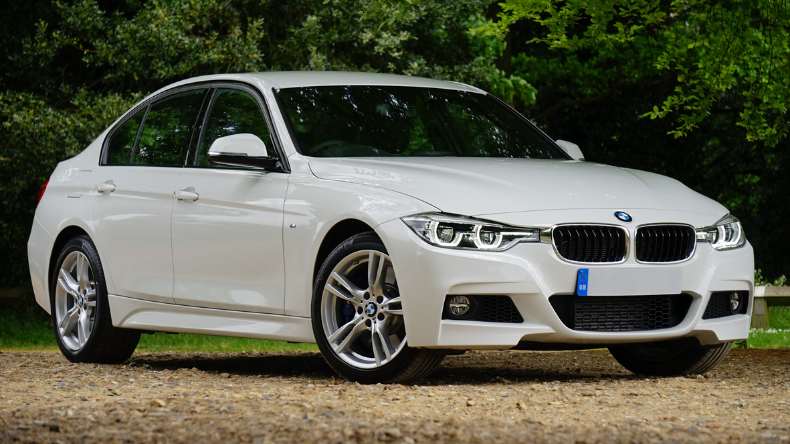
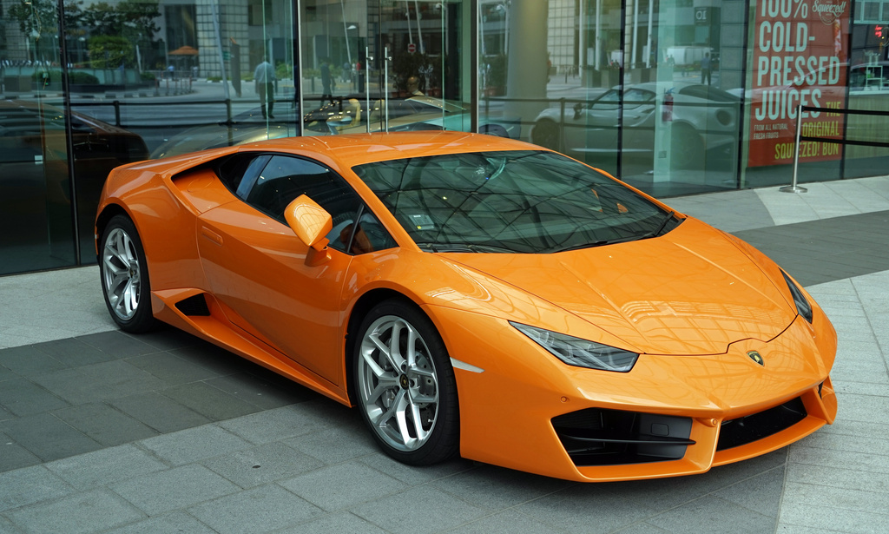




Saudi Arabia Used Cars
Hesti Solikah
Purwadhika DIgital Technology School
Data Science and Machine Learning

Slide 2
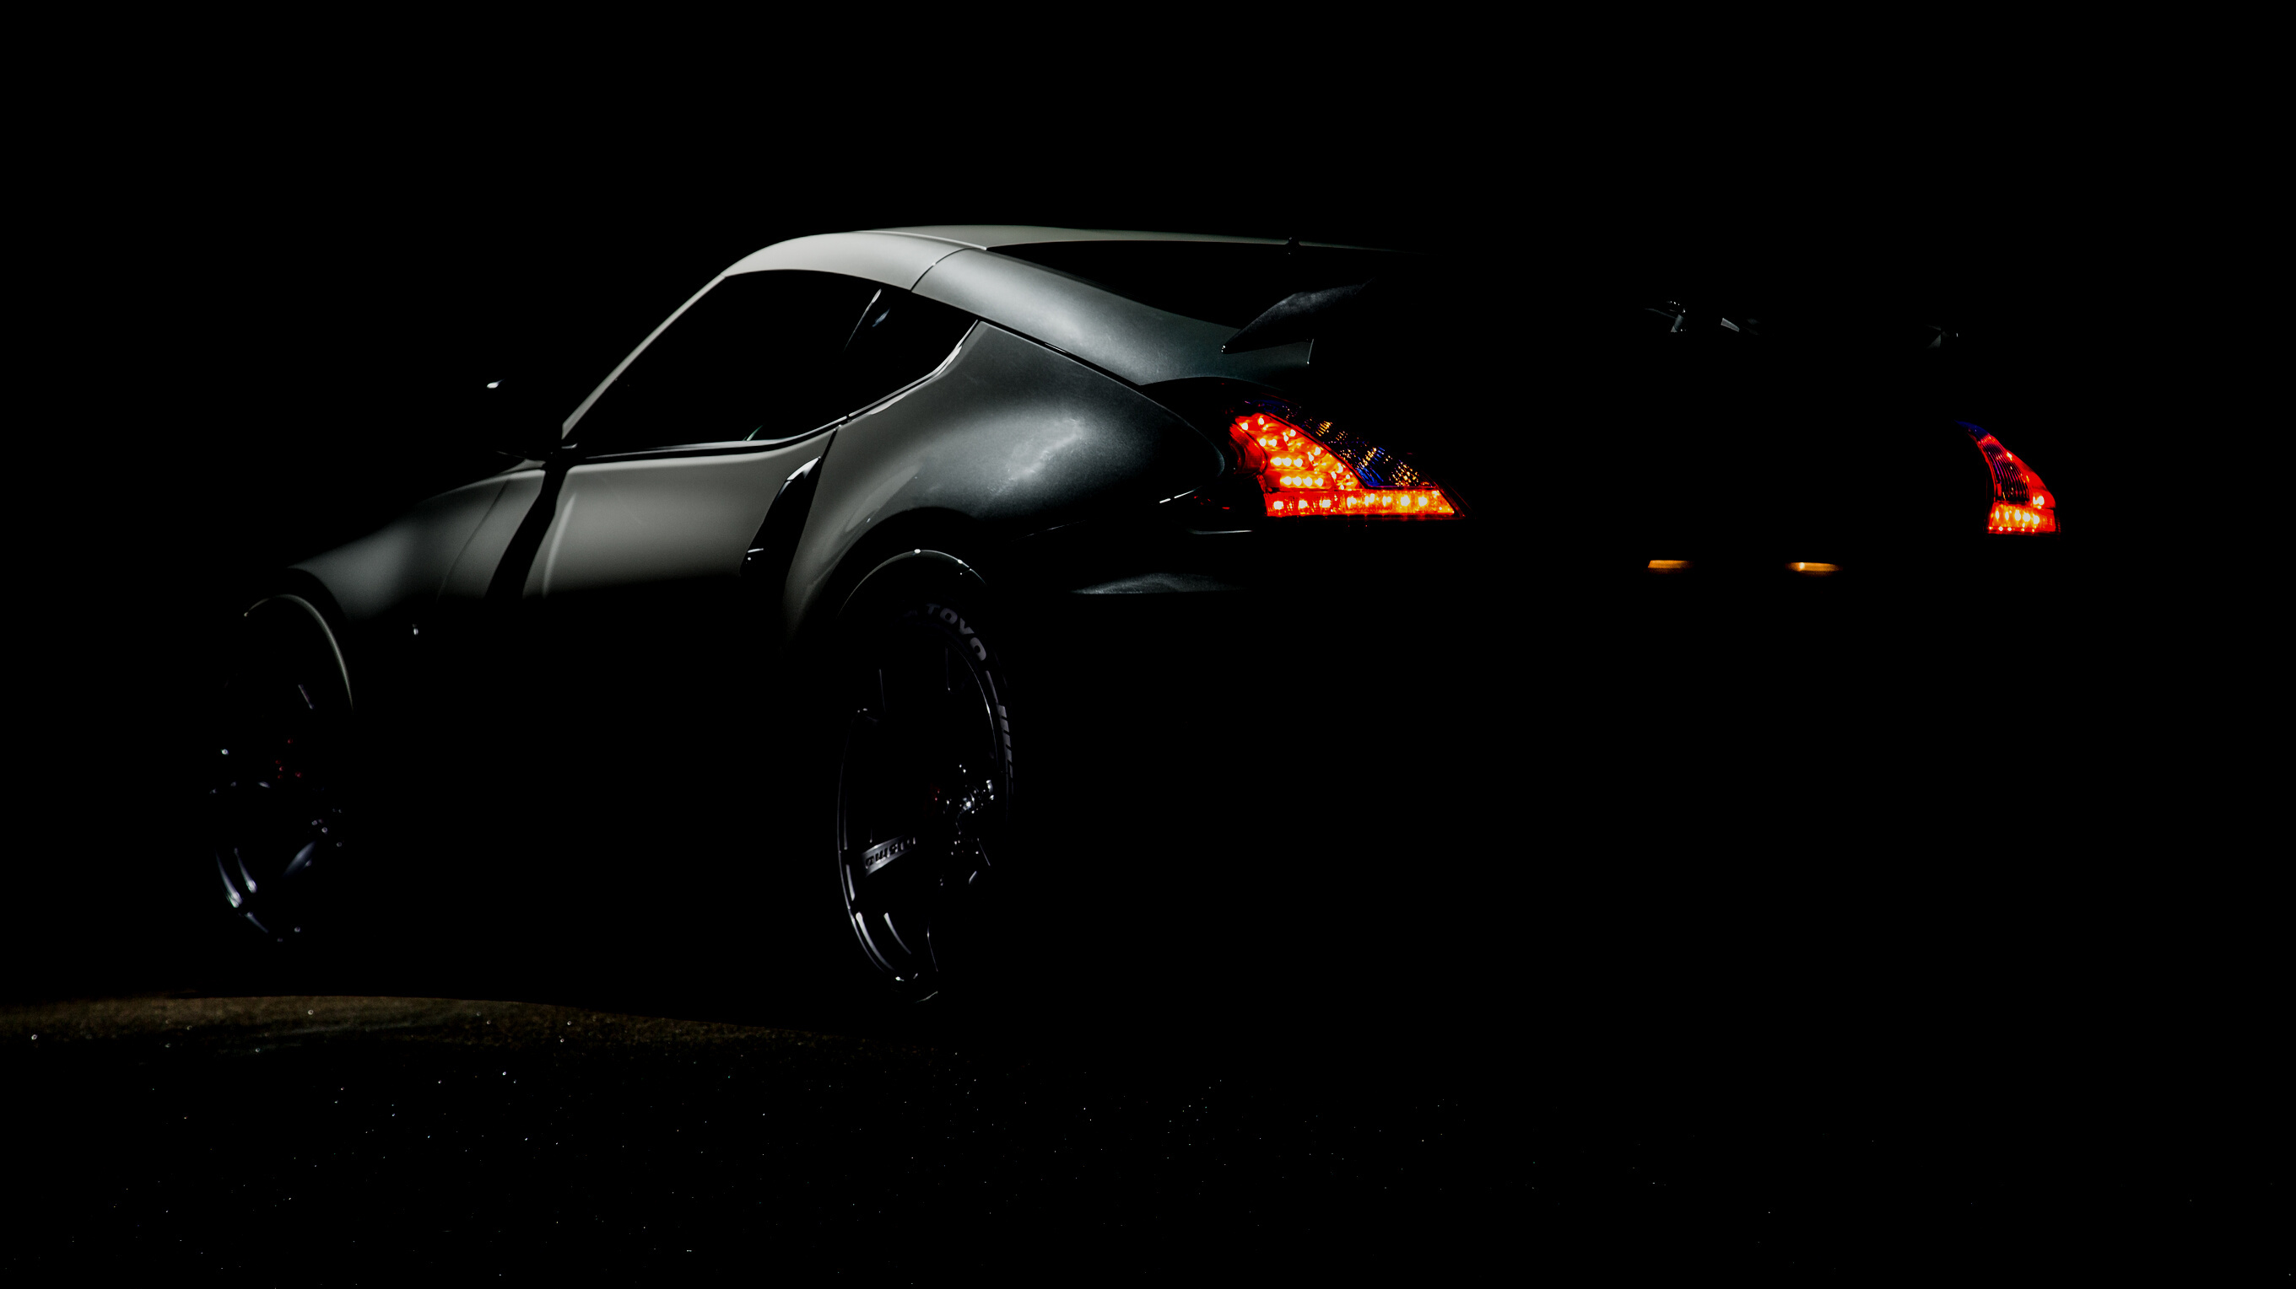

Content
1. Business Problem Understanding
4. Modelling
2. Data Understanding
5. Conclusion
3. Data Preprocesssing
6. Recommendation

Slide 3
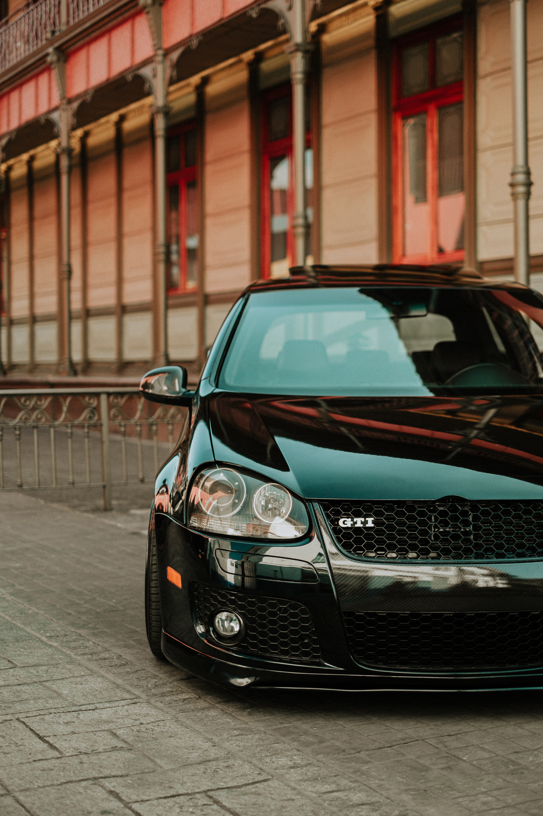




Business Problem Understanding
Context
Goal
Cars are one of the most needed modes of transportation in Saudi
Arabia.Used cars have a 2x market compared to new cars.
Create a Machine Learning model that can predict accurate and competitive used car prices.
Analytic Approach
Analysis of patterns or trends in features that distinguish one model from another and then create a regression model to predict used car prices.
Problem Statement
The difficulty of determining accurate and competitive used car prices

Slide 4
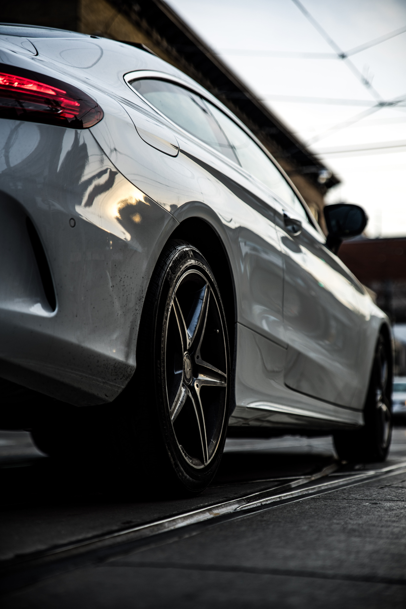
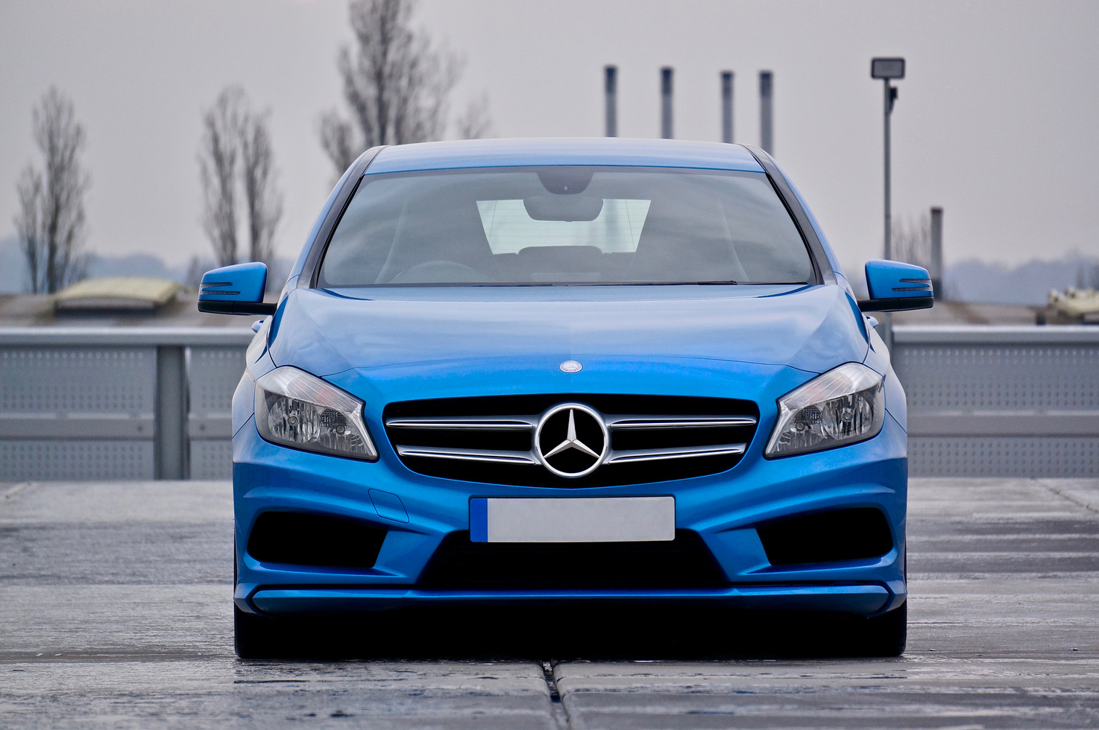
Evaluation
Metrics
MAE, Mean Absolute Error
MAPE, Mean Absolute Percentage Error
RMSLE, Root Mean Squared Log Error
R-SQUARE

Slide 5
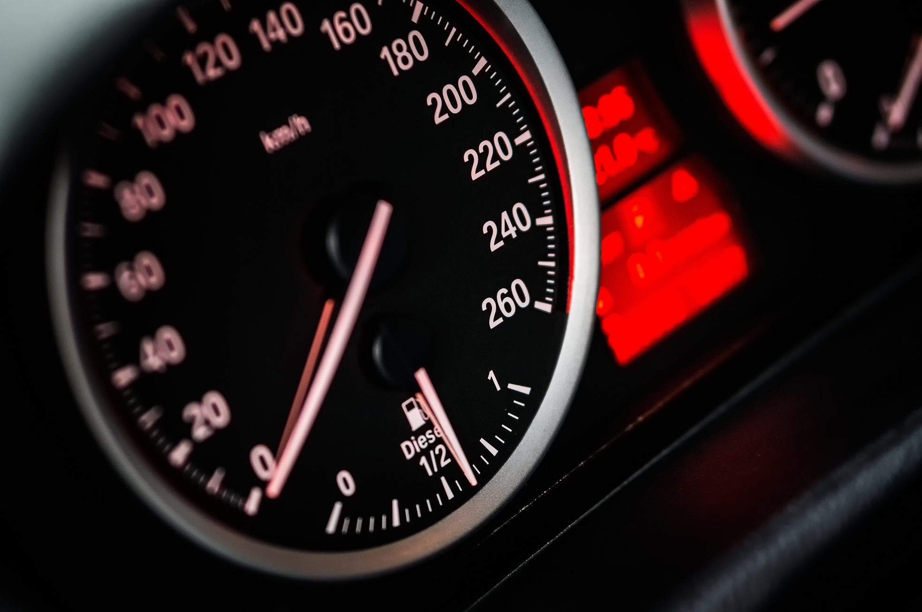

Data Understanding
Saudi Arabia Used Cars
Numeric Variable :
Price, Year, Engine_Size, Mileage
Categoric Variable :
Type, Region, Make, Gear_Type, Origin, Negotiable, dan Options.
5624
11
row
column

Slide 6
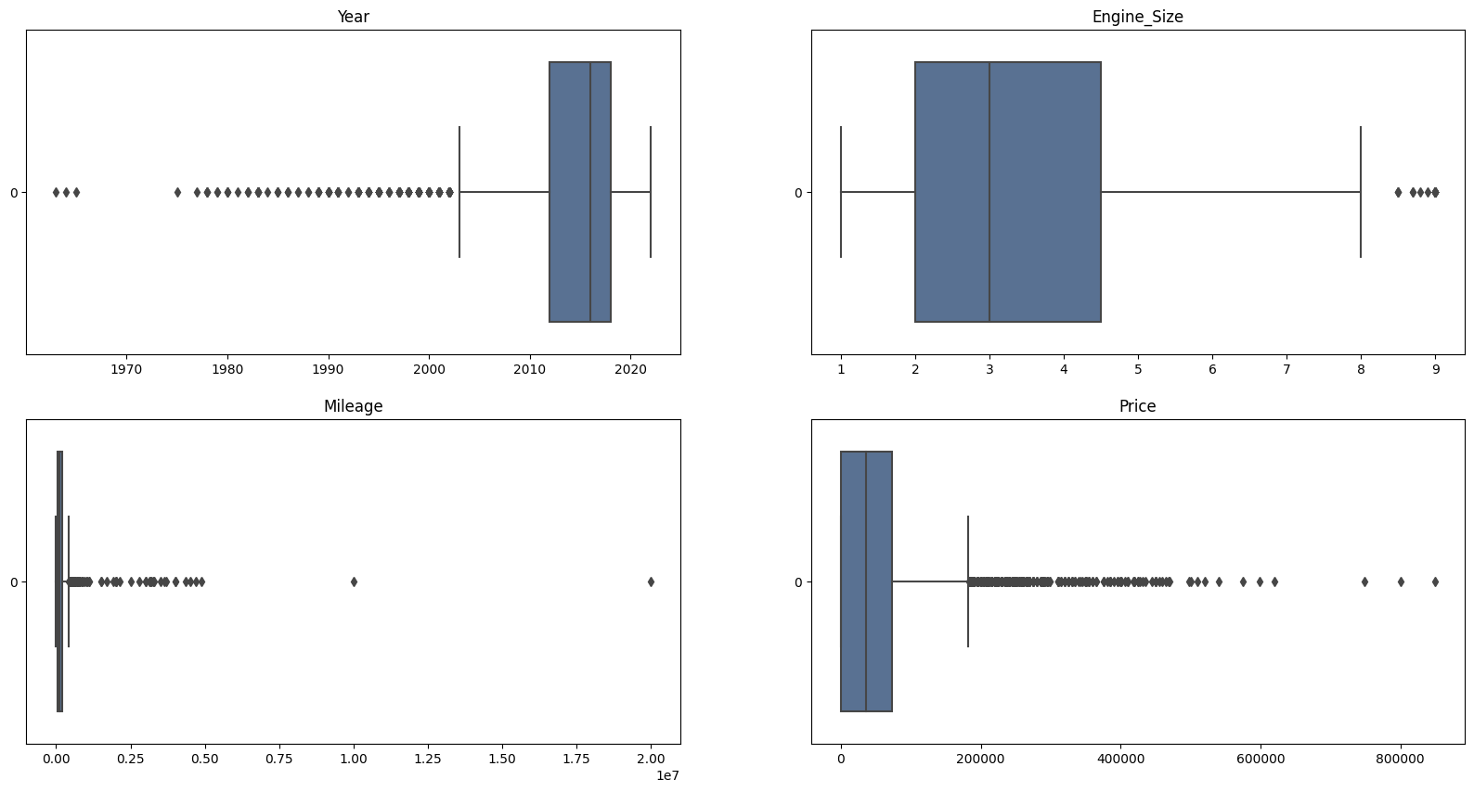


Data
Preprocessing
Data Cleaning
Feature Selection
Outlier
Column drop:
Origin
Negotiable
Price < 5000 SAR
Mileage > 999999 KM
Missing Value = 0
Duplicate Data = 4

Slide 7

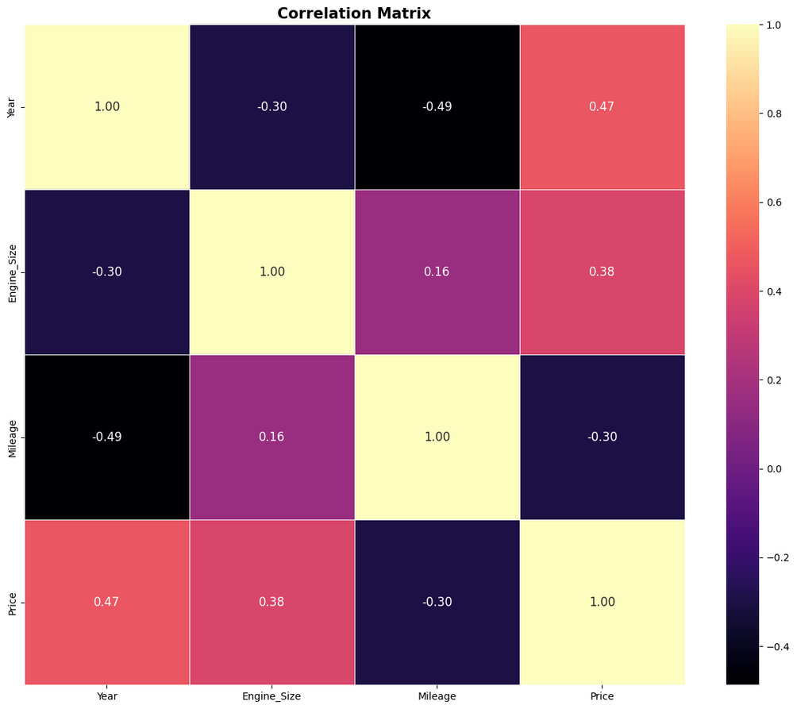
Correlation Matrix
Multicollinearity is then checked from the metrics:
Variables with VIF score
Year (7,096945)
Engine_Size (6,820956)
Mileage (2,747905)
Price (2,795582)

Slide 8
MODELLING
One Hot Encoder :
Gear_Type
Options
Binary Encoder:
Region
Make
Split Data Train : Test
70 Train : 30 Test
Encoding

Slide 9
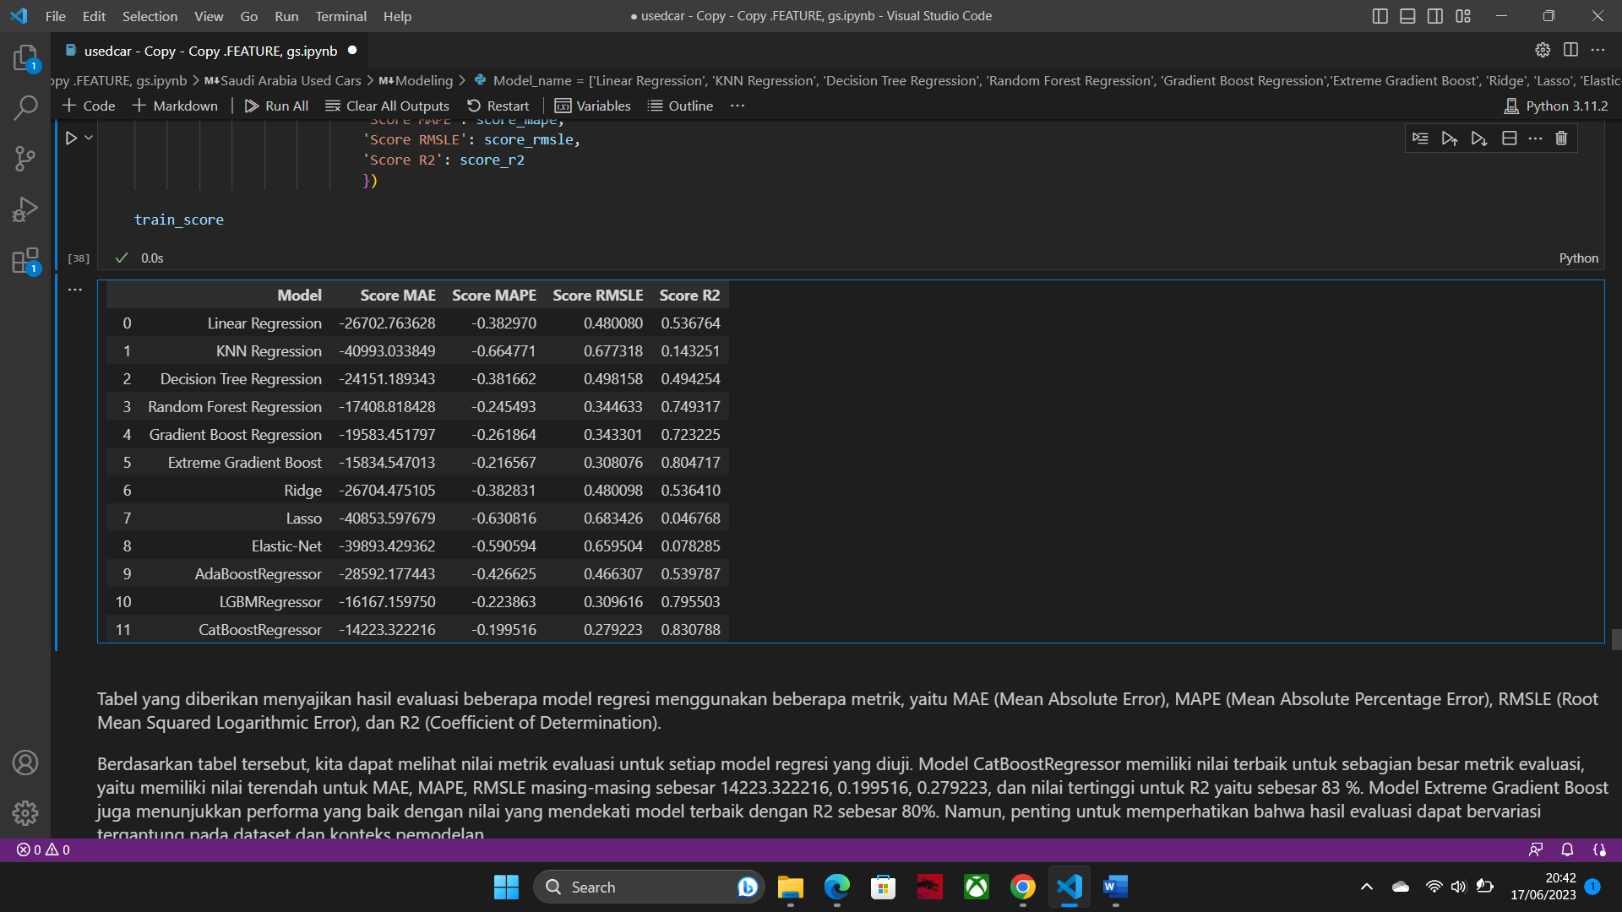
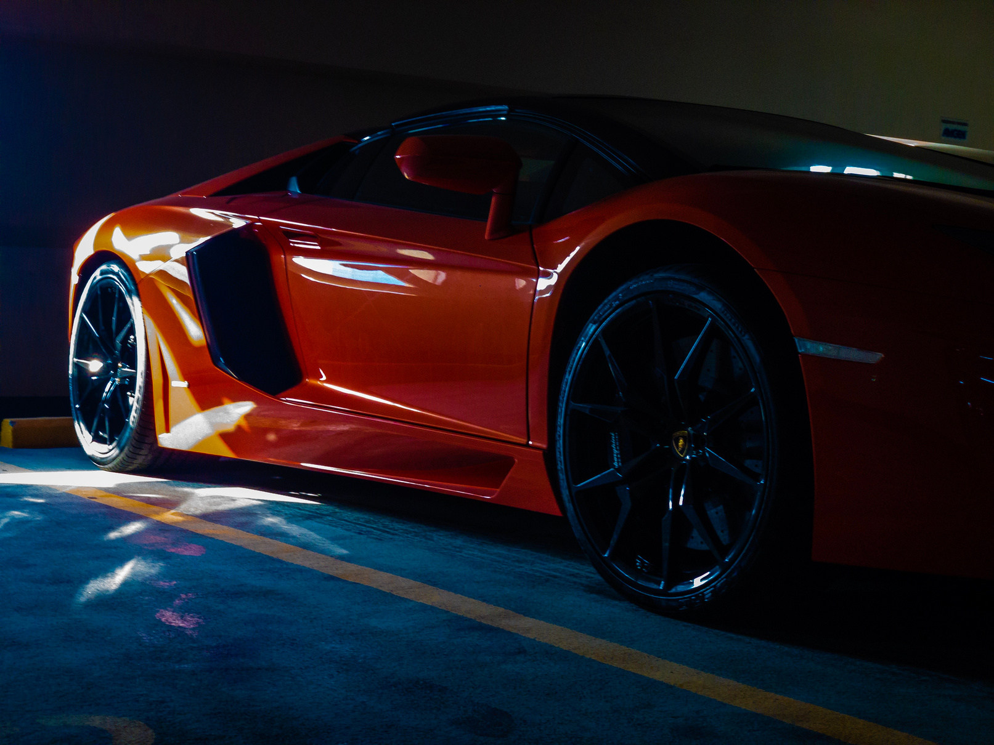
CHOOSING BENCHMARK MODEL
The CatBoostRegressor model has the best values for most evaluation metrics, having the lowest values for MAE, MAPE, RMSLE, and the highest for R-square.

Slide 10
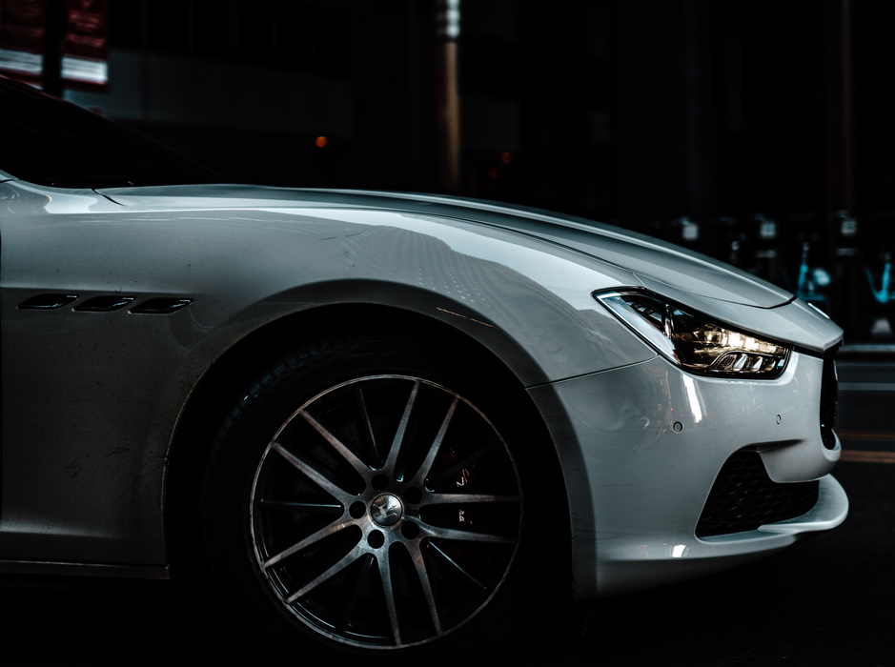
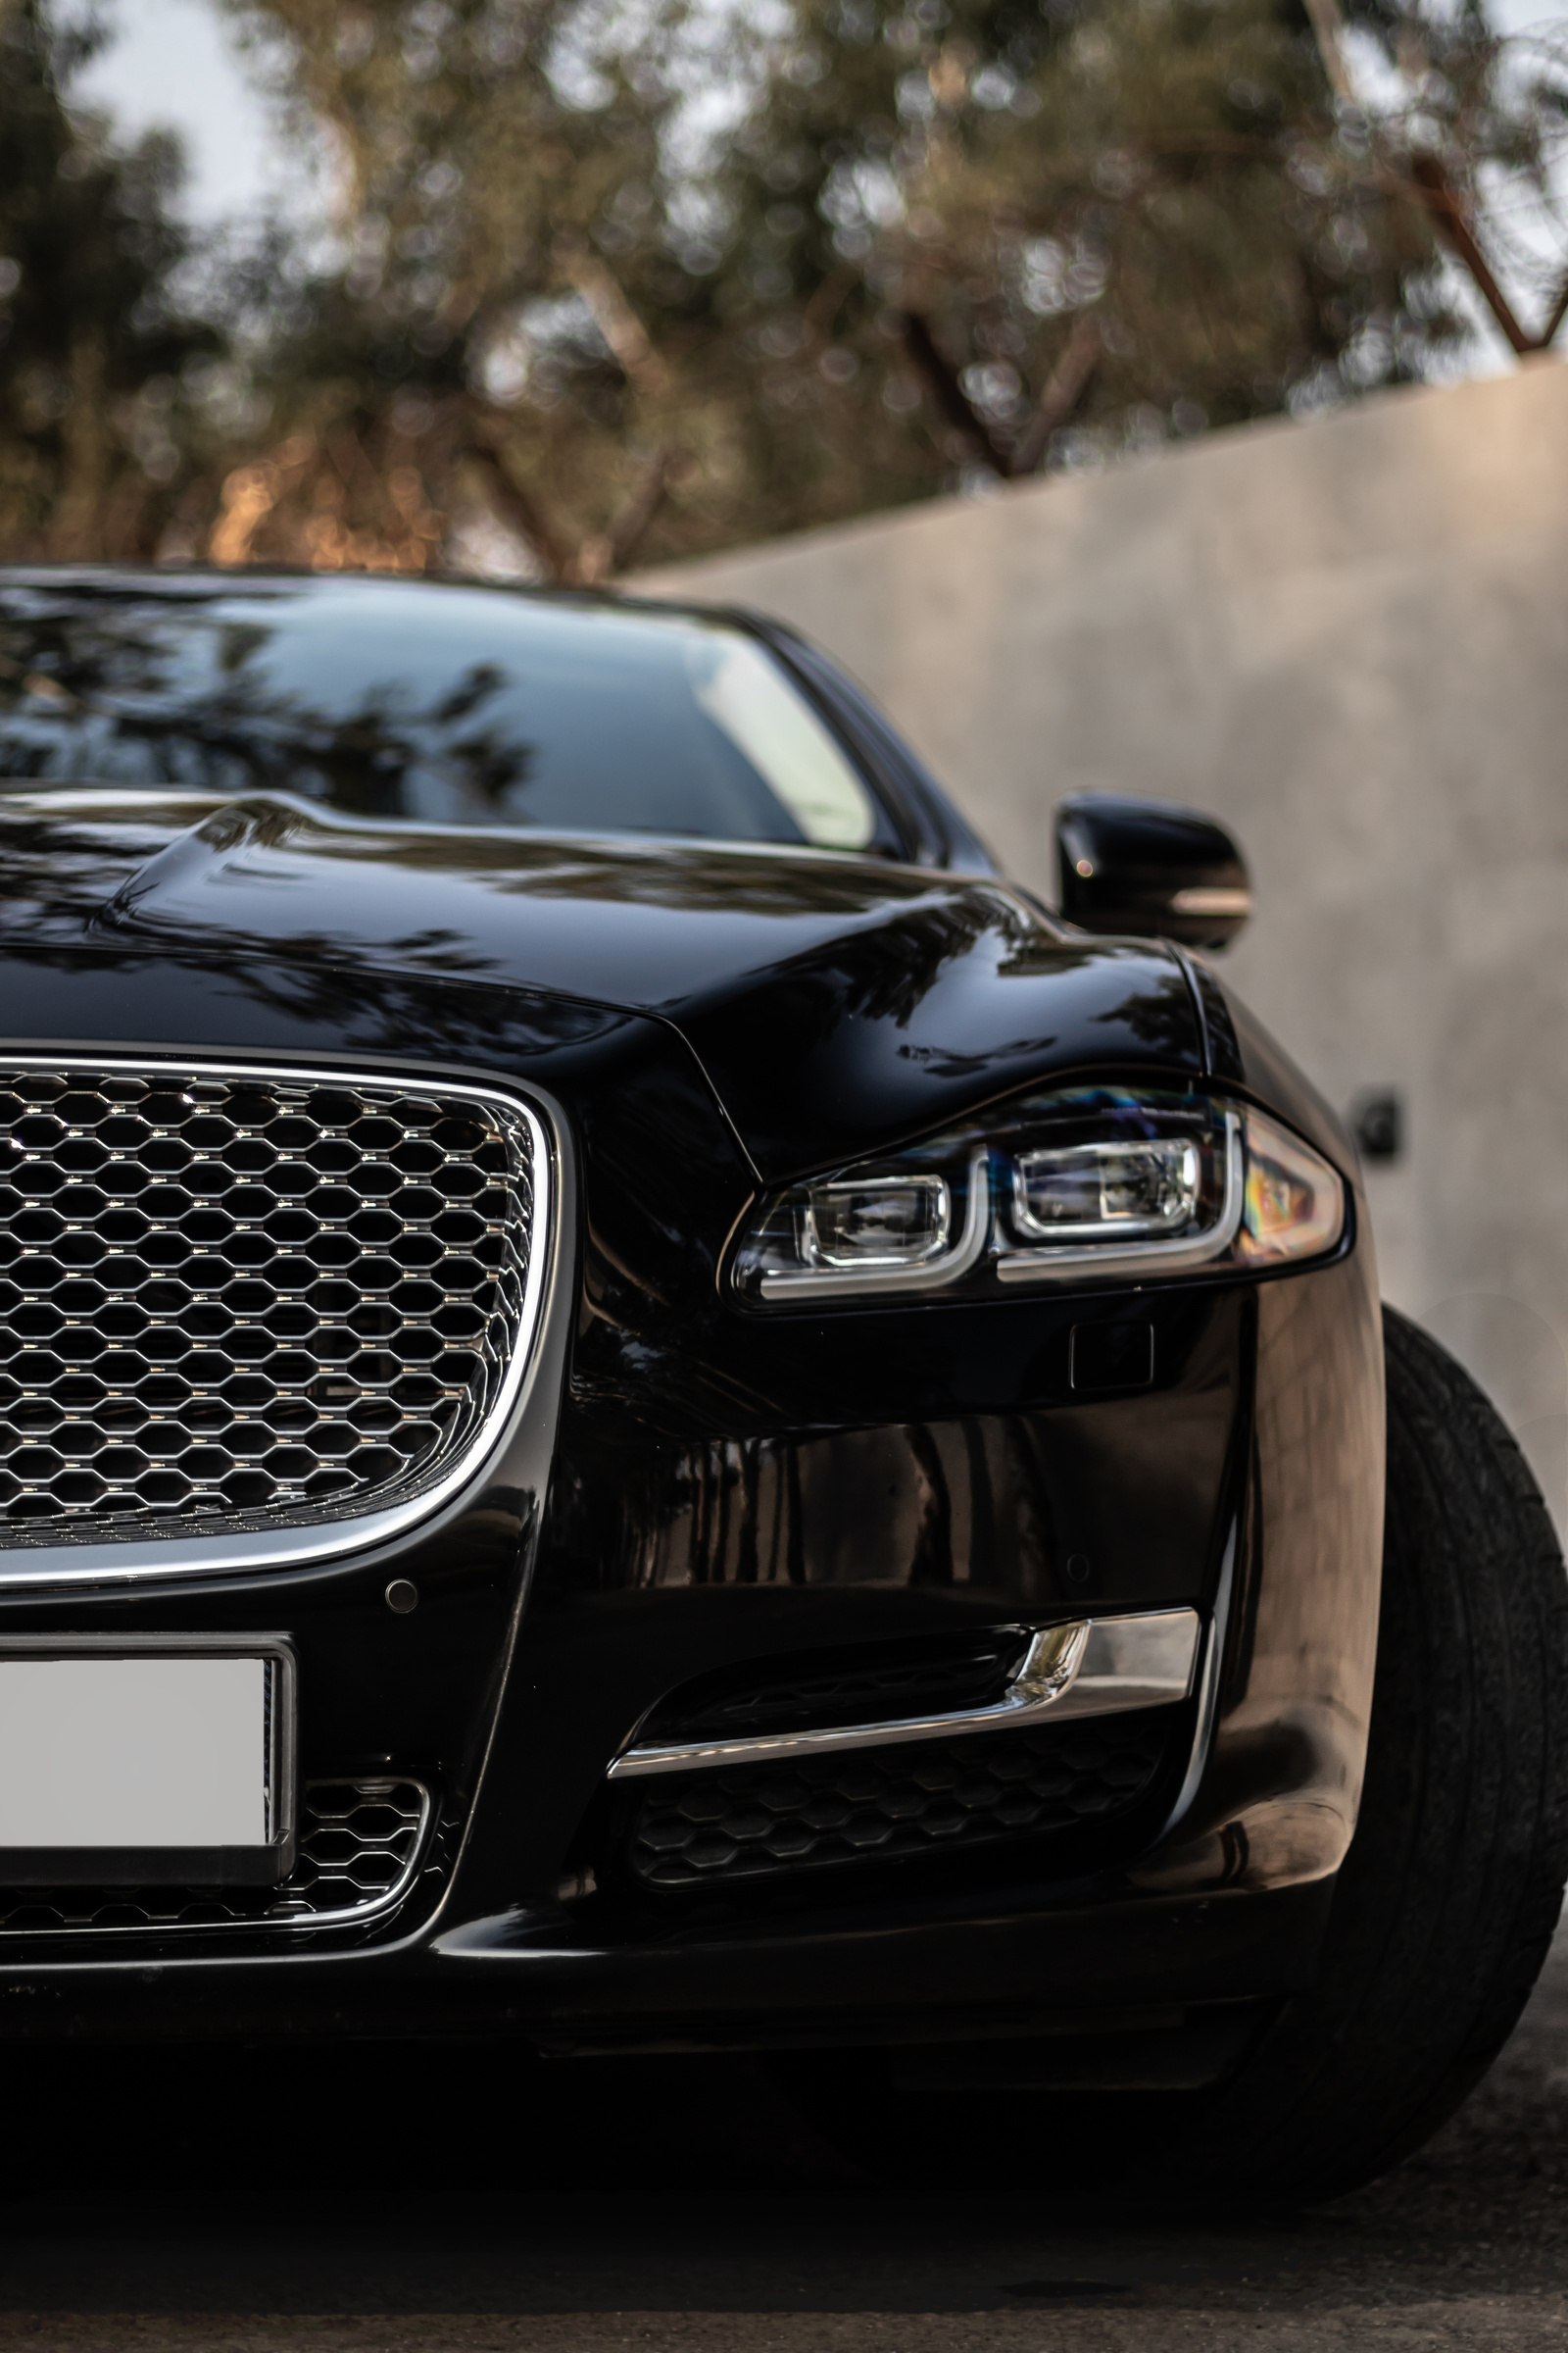

CATBOOST
CatBoost is a popular open-source library for machine learning. It is a framework developed by Yandex that is used to build efficient and accurate machine learning models. CatBoost uses a powerful gradient boosting method to improve the accuracy of regression models.

Slide 11
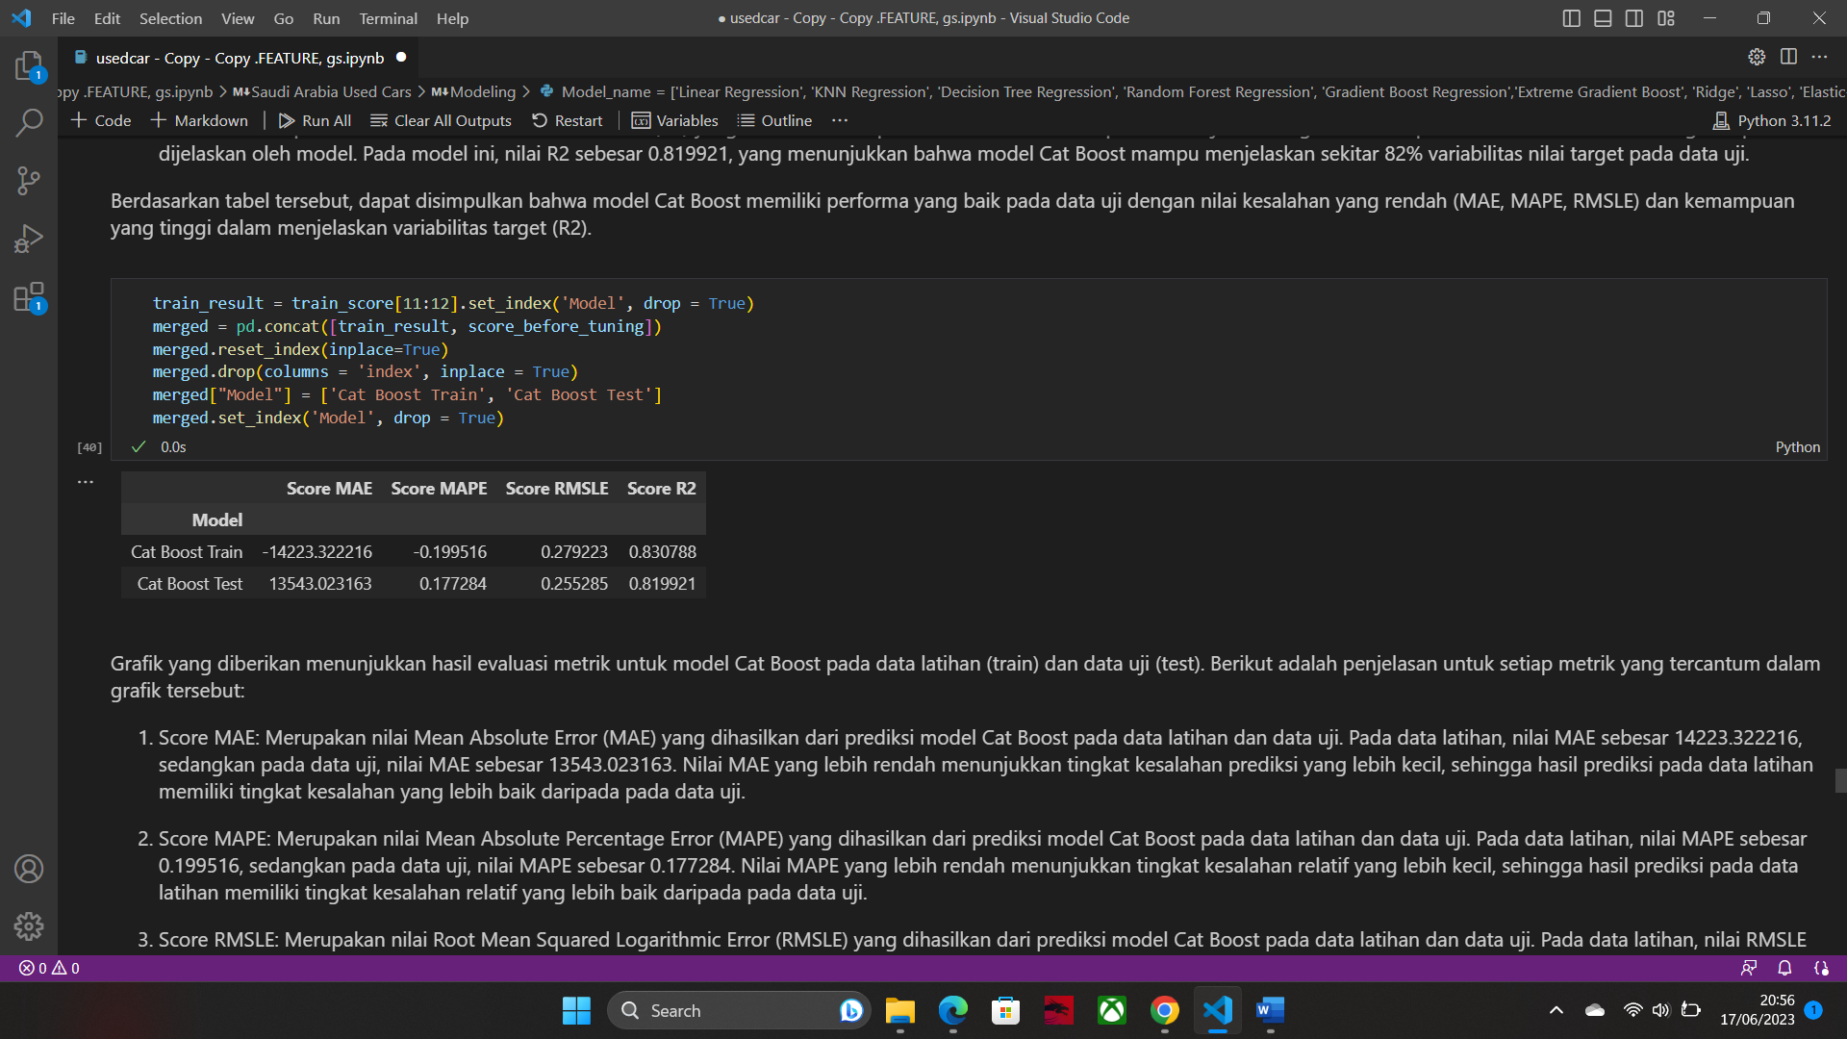



PREDICT TO TEST SET USING BENCMARK MODEL
The Cat Boost model provides good prediction results (seen from the low MAE, MAPE, and RMSLE)
on both train and test data.

Slide 12
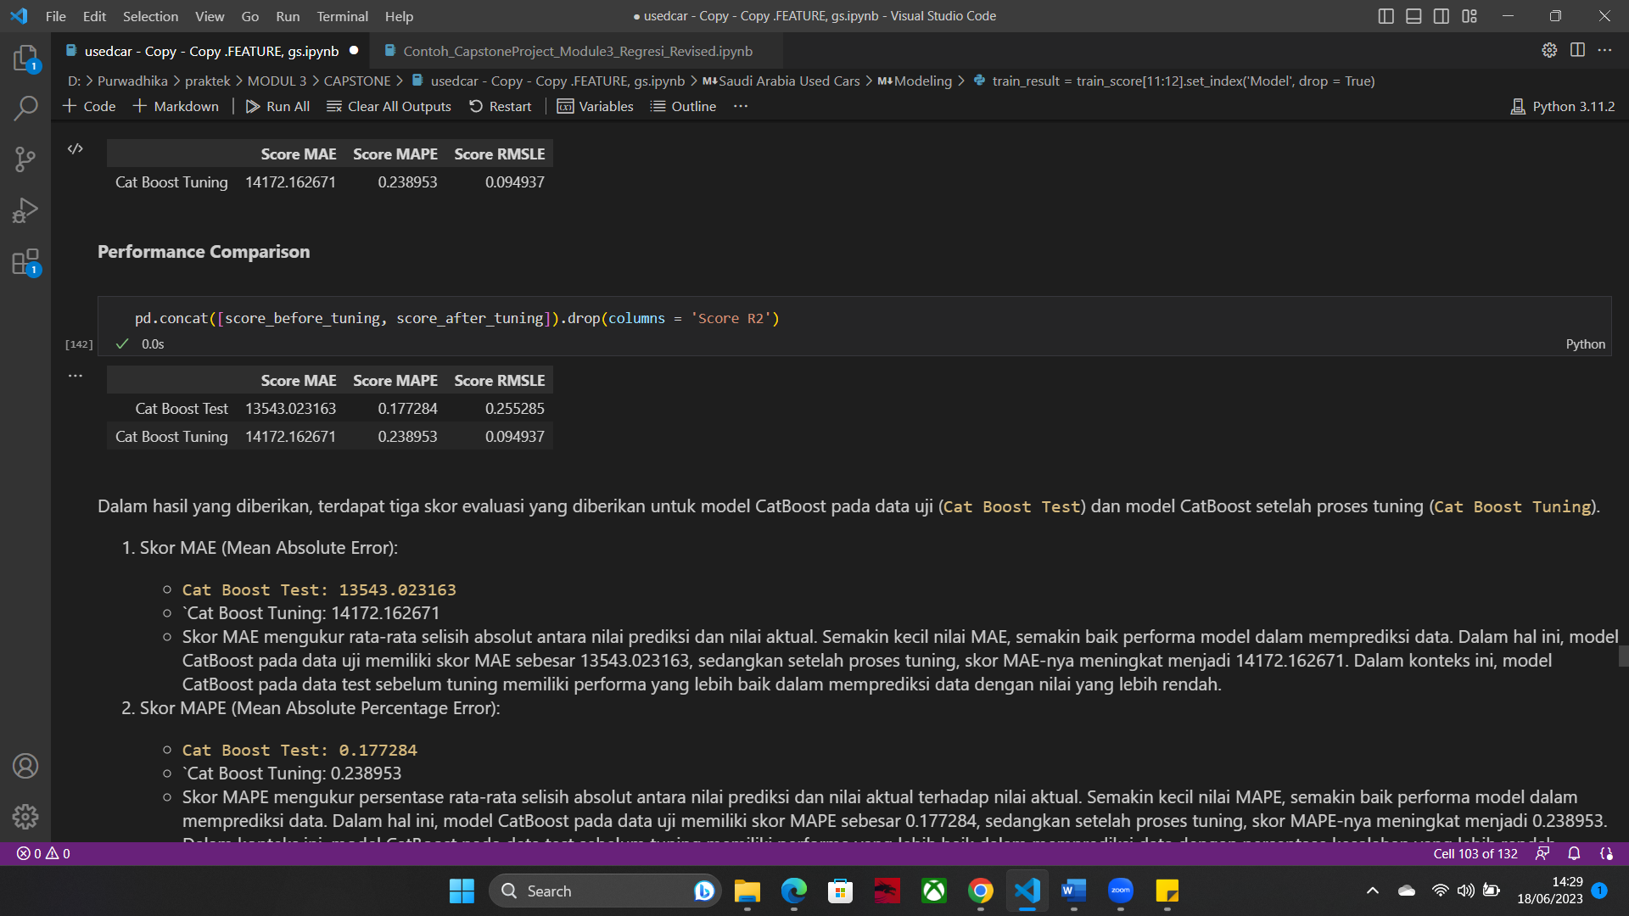
HYPERPARAMETER TUNING
(GRID SEARCH)
With the best parameter results using grid search:
'{'model__depth': 9
'model__iterations': 275
'model__l2_leaf_reg': 4
'model__learning_rate': 0.1}
Performance Comparison

Slide 13
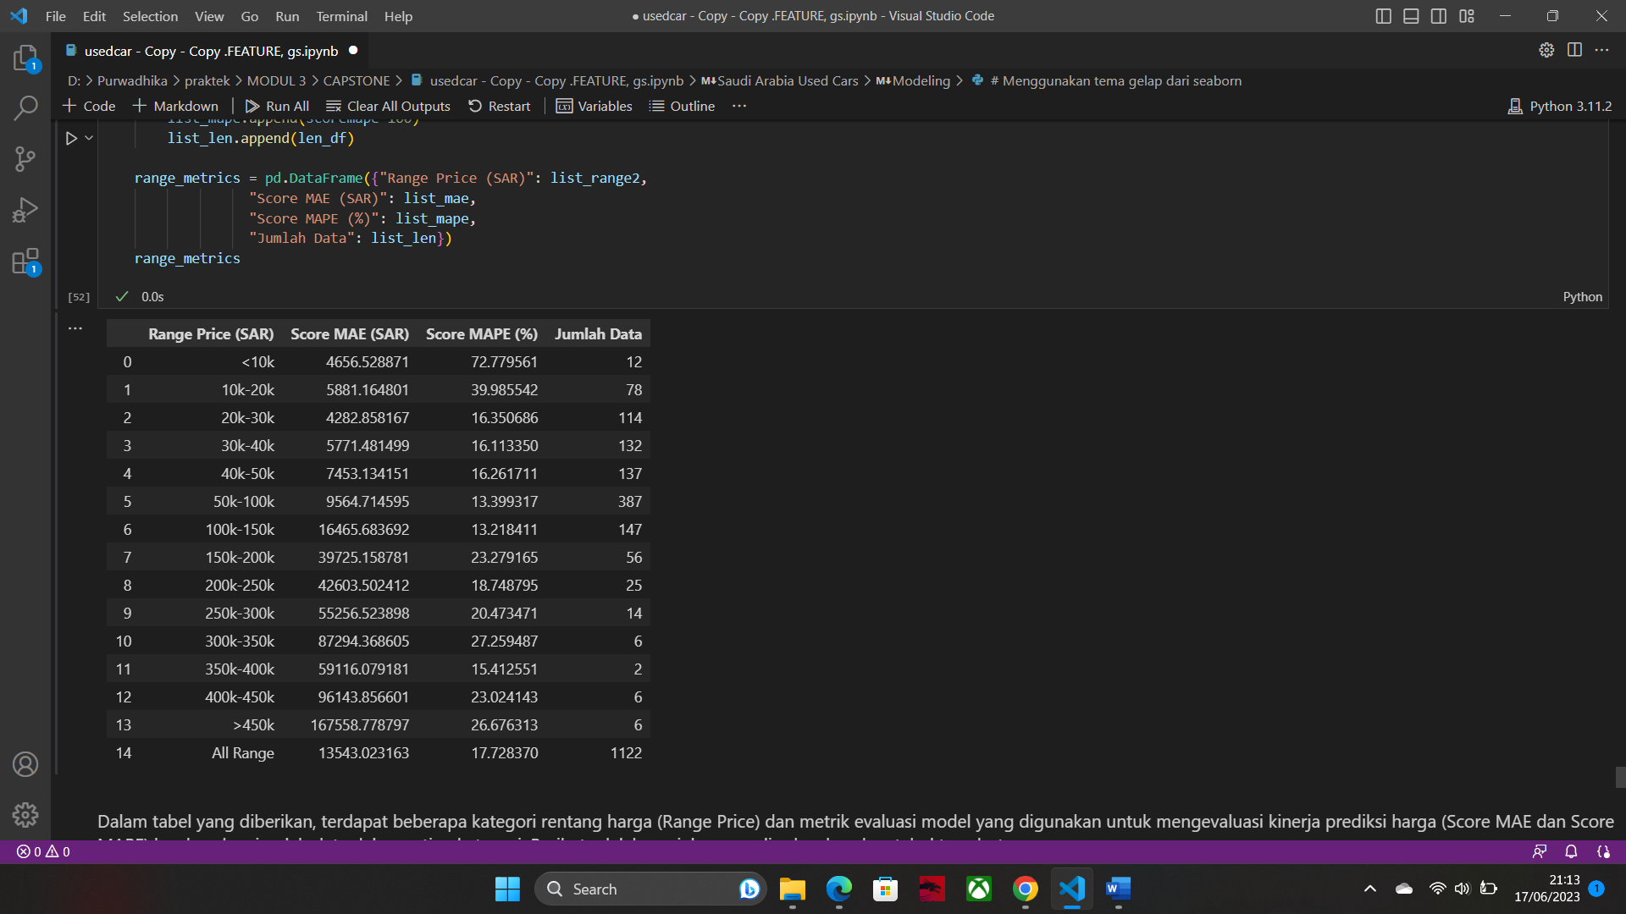
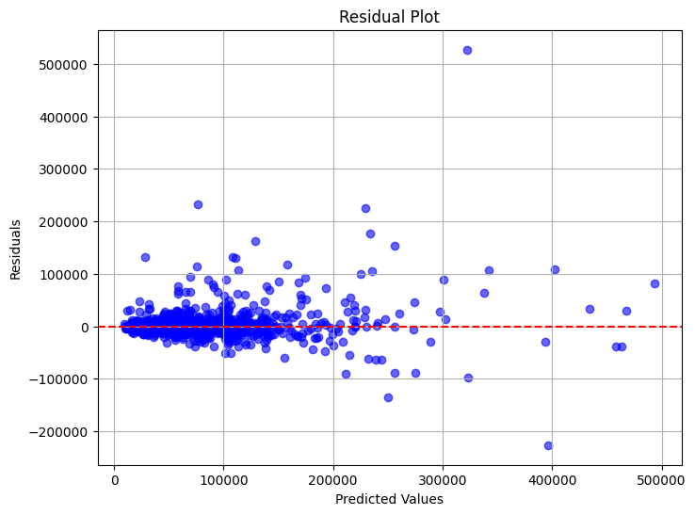

MODEL LIMITATION
Sport car racing series, was also among the winners in a clutch of victories
Model performance in predicting car prices
in each price range

Slide 14
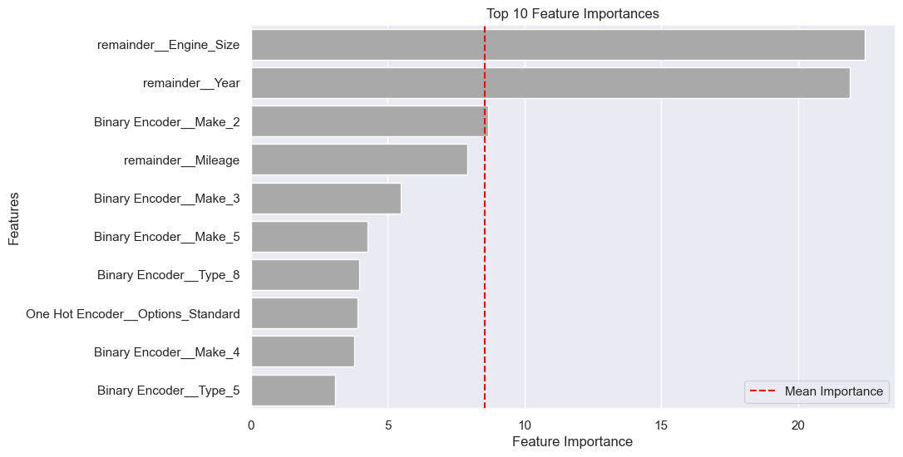
FEATURE IMPORTANCES
The higher the feature importance value, the more important the feature is in influencing the prediction of the target variable in the model.

Slide 15
CONCLUSION
The evaluation metric obtained in the model before hyperparameter tuning has a better result of MAPE 17.73%, dan MAE sebesar 13543 SAR.
The most influential features in this model are Engine Size, Year.
In the plot results on the price range table there is a limitation, this model is not suitable for cars that have a low price of less than 10000 SAR.

Slide 16
RECOMMENDATION
In the results of the model prediction in the used car range for prices below 10,000 riyals has a poor MAPE value of 72.78%. This result can be an improvement in the future.
Can consider using other better metrics
Conduct A/B trials to test the effectiveness of using the model in predicting used car prices.
Use more sophisticated algorithms to find the best model in predicting used car prices.
Adding car data such as car color, review of the car whether it is worth buying, car condition, warranty from the car.

